Slide 1
Analysis of Covariance, ANCOVA (GLM2)
Prof. Andy Field

Slide 2
Aims
When and Why do we use ANCOVA?
Partitioning Variance
Carrying out on IBM SPSS
Interpretation
Main Effects
Covariates

Slide 3
When And Why
To test for differences between group means when we know that an extraneous variable affects the outcome variable.
Used to control known extraneous variables.

Slide 4
Advantages of ANCOVA
Reduces Error Variance
By explaining some of the unexplained variance (SS_{R}) the error variance in the model can be reduced.
Greater Experimental Control:
By controlling known extraneous variables, we gain greater insight into the effect of the predictor variable(s).

Slide 5
Variance
SS_{T}
Total Variance In The Data
SS_{M}
SS_{R}
Improvement Due to the Model
Error in Model
Covariate
SS_{R}

Slide 6
An Example
We will use Field’s (2013) Viagra example (from the ANOVA lecture).
There are several possible confounding variables – e.g. Partner’s libido, medication.
We can conduct the same study but measure partner’s libido over the same time period following the dose of Viagra.
Outcome (or DV) = Participant’s libido
Predictor (or IV) = Dose of Viagra (Placebo, Low & High)
Covariate = Partner’s libido

Slide 7
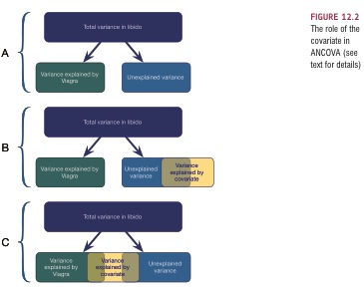
Relationships between the IV and Covariate

Slide 8
Homogeneity of Regression Slopes

Slide 10
How Does ANCOVA Work?
Imagine we had just two groups:
Placebo
Low Dose
This paradigm can be expressed as a regression equation using a dummy coding variable:

Slide 11
Dummy Coding
Dummy Coding
Placebo = 0, Low Dose = 1
When Dose = Placebo, Predicted Libido = mean of placebo group:
When Dose = Low Dose, Predicted Libido = mean of Low Dose group:

Slide 12
ANOVA As Regression
We can run a regression with Libido as the outcome and the Dose (Placebo or Low) as the predictor, Note:
Intercept is the mean of Placebo group
b for the Dummy Variable is the difference between the means of the placebo and low dose group (4.88-3.22 = 1.66)

Slide 13
ANCOVA
ANCOVA extends this basic idea.
The covariate can be added to the regression model of the ANOVA.
To evaluate the effect of the experimental manipulation controlling for the covariate we enter the covariate into the model first (think back to hierarchical regression).

Slide 14
To Recap
To control for the effect of a covariate all we do is do a multiple regression in which we enter the covariate in the first step.
We enter Dose in a second step
The result is that we see the effect of dose above and beyond the effect of the covariate.

Slide 16
1.66

Slide 17
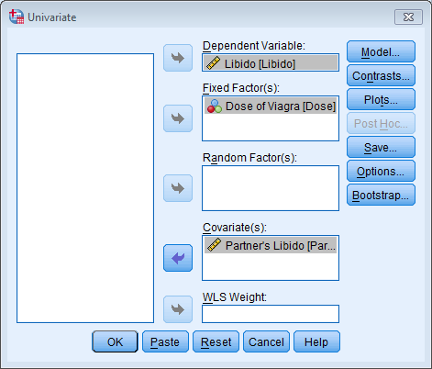
ANCOVA on IBM SPSS

Slide 18
Contrasts

Slide 19
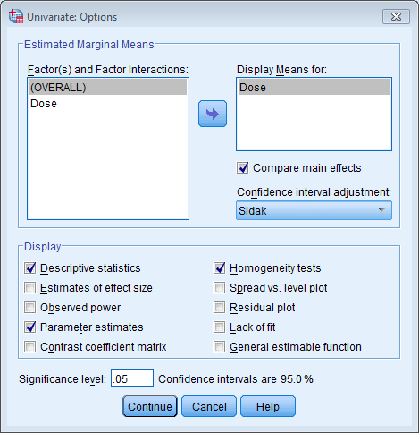
Options

Slide 20
Without the Covariate

Slide 21
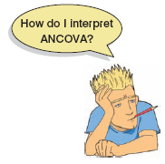
Output

Slide 22
Output Continued

Slide 23
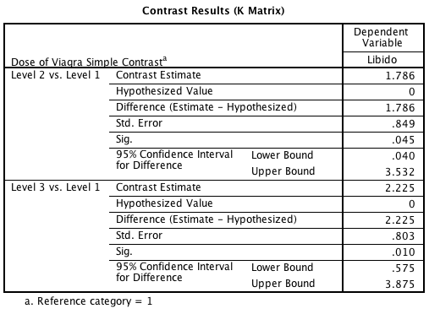
SPSS Output: Contrasts

Slide 24
Output: Pairwise Comparisons

Slide 25
Unadjusted Means
4.88
4.85
3.22

Slide 26
The Main Effect
F(2, 26) = 4.14, p < .05

Slide 27
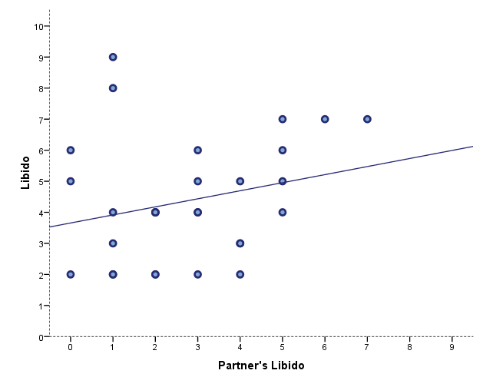
The Covariate
F(1, 26) = 4.96, p < .05

Slide 28
Calculating the Effect Size of Main Effects

Slide 29
Calculating Effect Size of Contrasts

Slide 30
Reporting Main Effects
The covariate, partner’s libido, was significantly related to the participant’s libido, F(1, 26) = 4.96, p = .035, r = .40. There was also a significant effect of Viagra on levels of libido after controlling for the effect of partner’s libido, F(2, 26) = 4.14, p = .027, partial η² = .24.

Slide 31
Reporting Contrasts
Planned contrasts revealed that having a high dose of Viagra significantly increased libido compared to having a placebo, t(26) = −2.77, p = .01, r = .48, but not compared to having a low dose, t(26) = −0.54, p = .59, r = .11.

